Slide 1
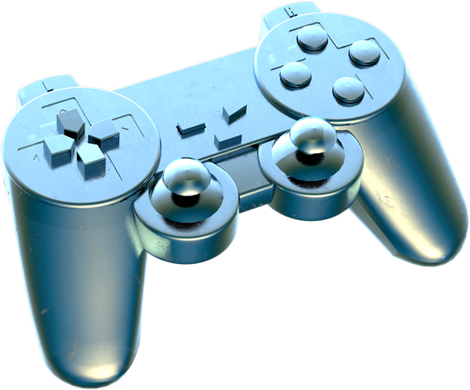
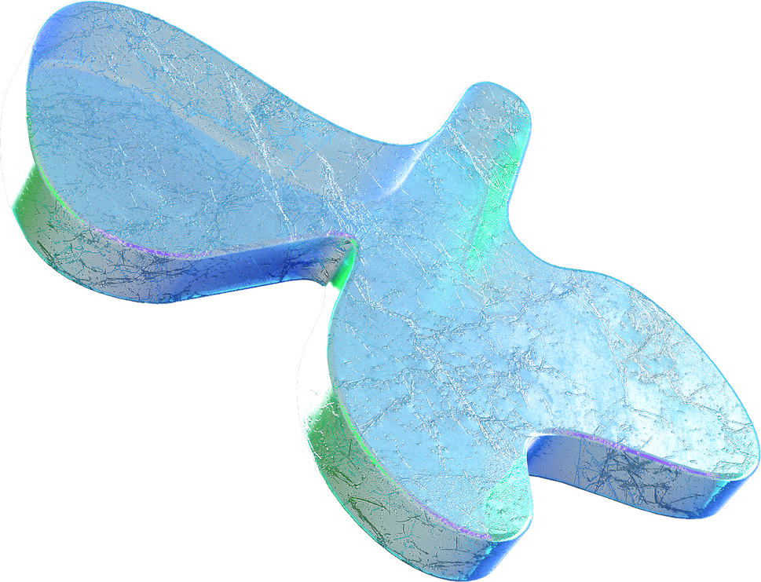
CA1 CLASSIFICATION
Predicting Water Quality
REJEY EZEKIEL JEYAKUMAR (2348935)

Slide 2

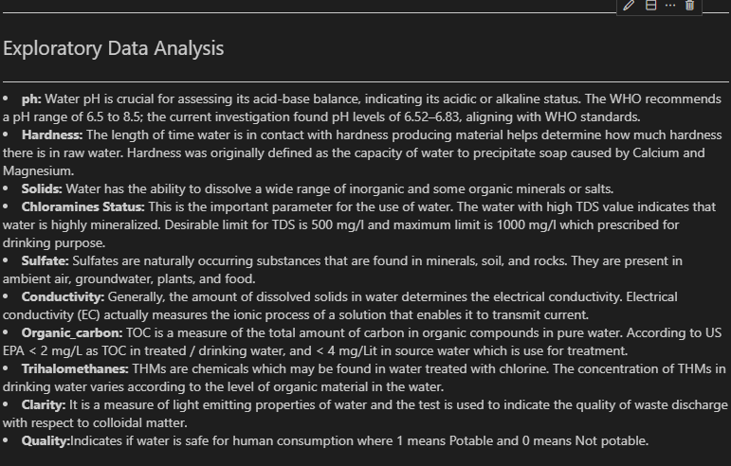
1.EDA

Slide 3
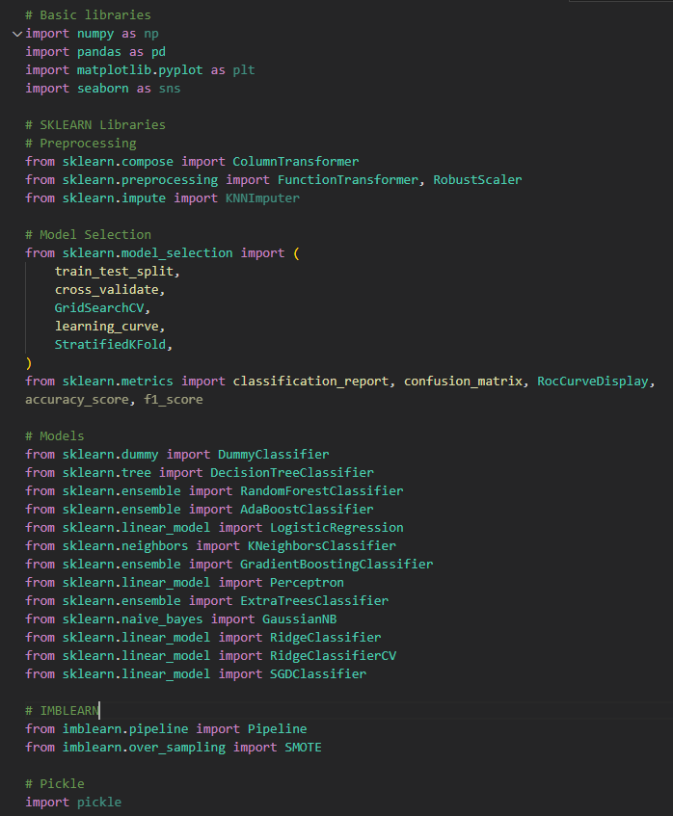
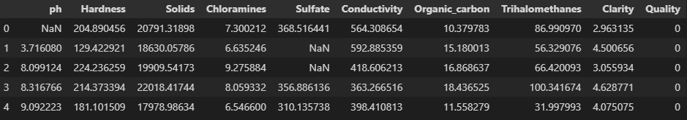
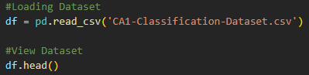
1.Importing
I imported libraries used for classification.
Secondly i imported my excel file.
Viewing the file

Slide 4
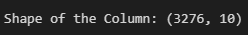
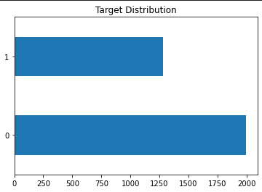
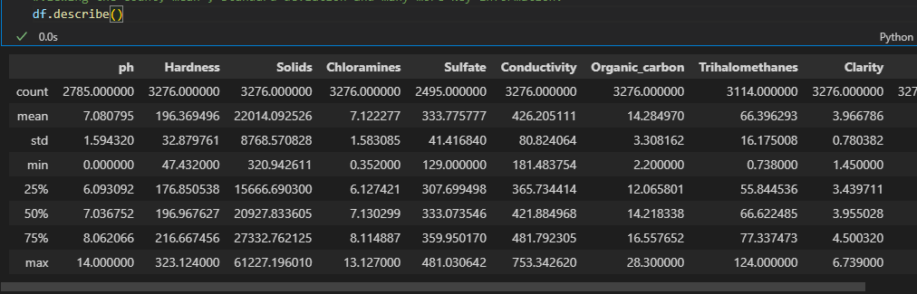
2.Viewing Outline
Viewing outline of the dataset
Viewing the columns of the dataset
Seeing key information like the min, max, SD and many more key data.
Viewing the Target (Quality) Distribution

Slide 5
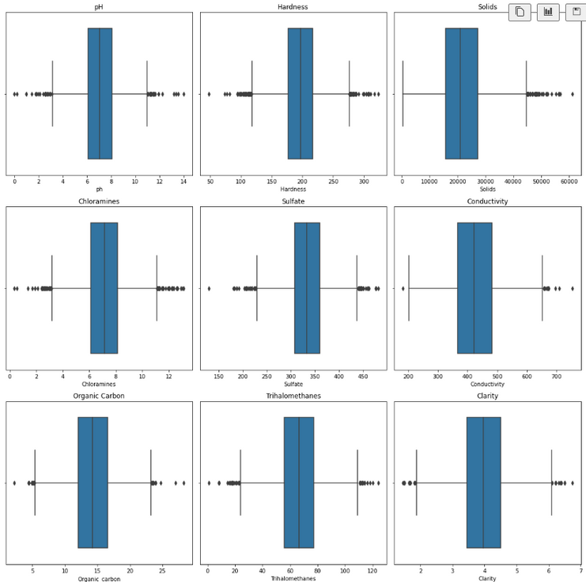
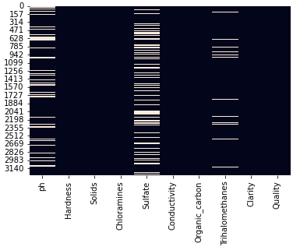
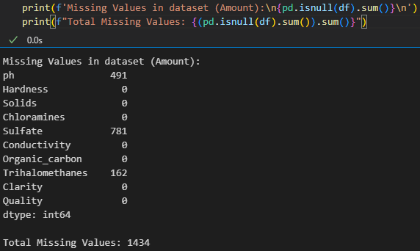
3. Viewing Missing values in Dataset
Missing Values in the dataset.
Visualizing the missing data.

Slide 6
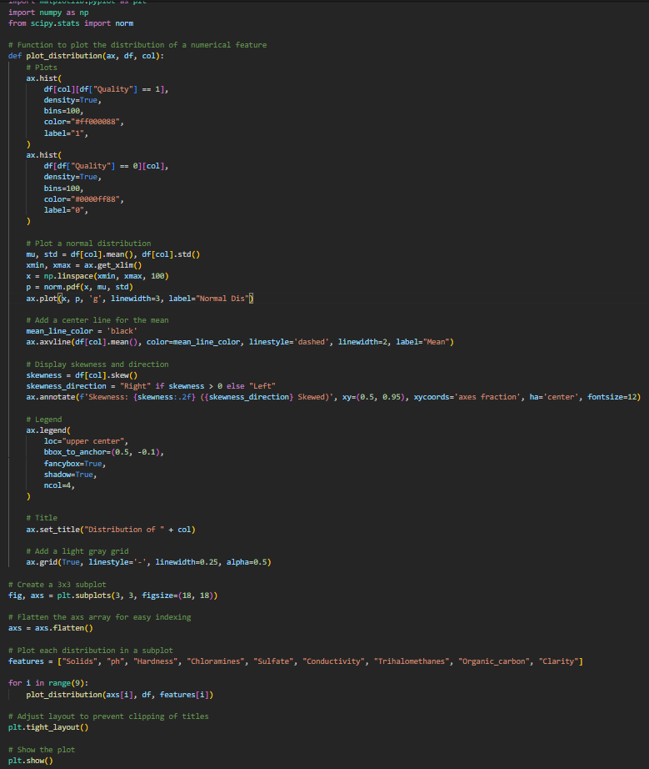
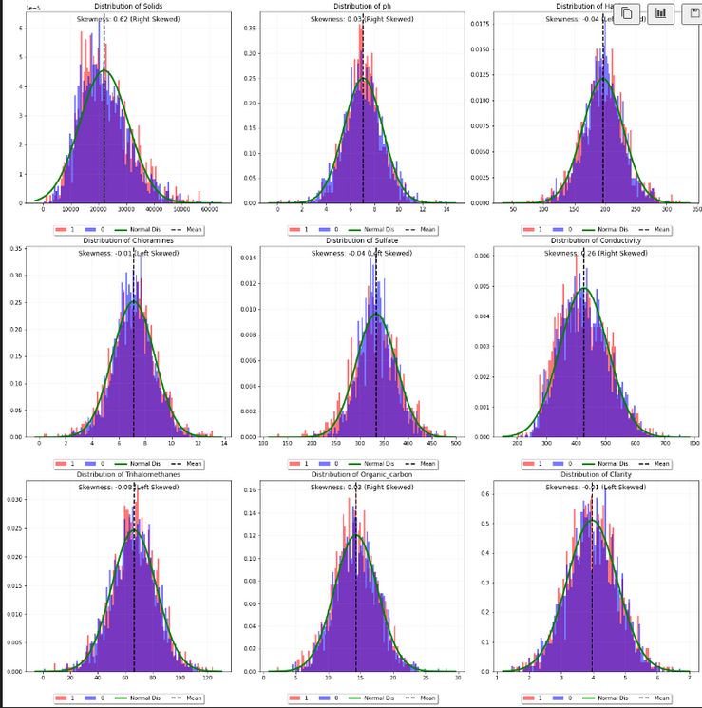
4. Uni variate Analysis
Visualizing the columns with our target (Quality)
most are almost normal but shows no correlation with Quality
with the highest skew being conductivity of 0.26 Right Skew

Slide 7
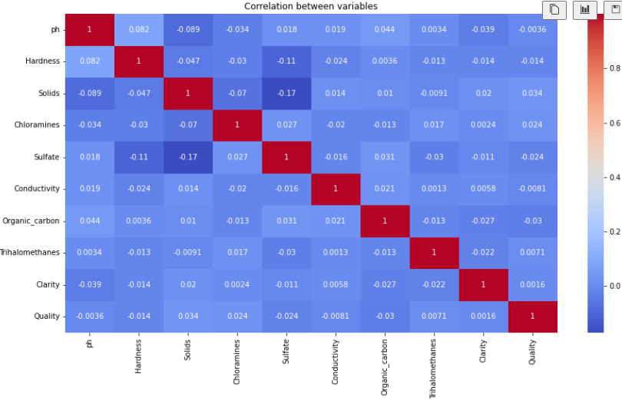
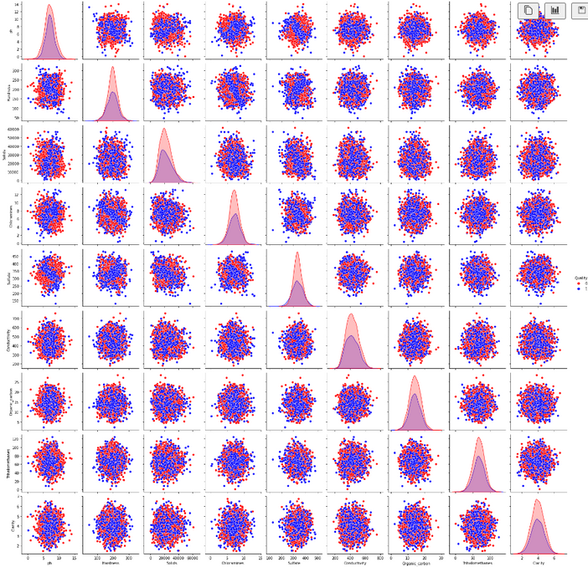
5. Bi variate Analysis
1. Visualising correlation between each feature
The dataset shows very low correlation between one another and the highest being 0.034

Slide 8
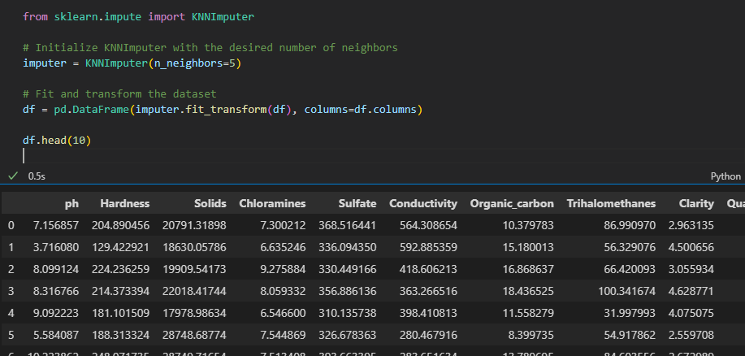
6. Data Preperation
1. Dealing with missing values
I am using Knn Imputer as it imputes missing values based on the nearest neighbors, which means it preserves the underlying relationships in the data

Slide 9
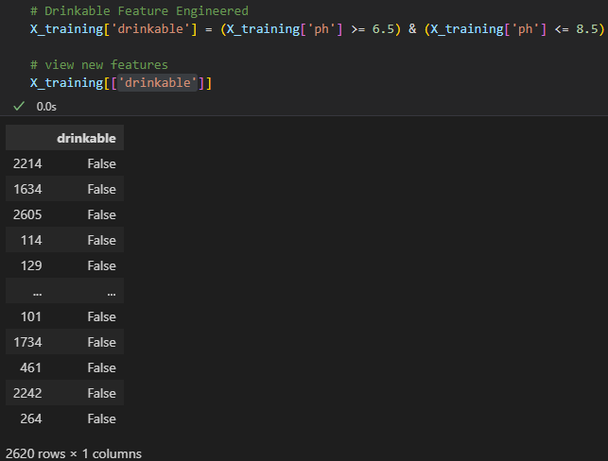
7. Feature Engineering
Drinkable Feature engineering
To Make the model perform better i have created a new feature called drinkable where WHO has given guideline for drinkable water and not drinkable water.

Slide 10
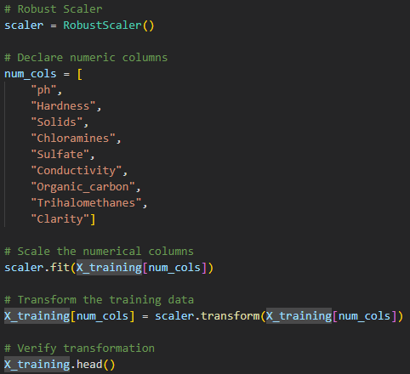
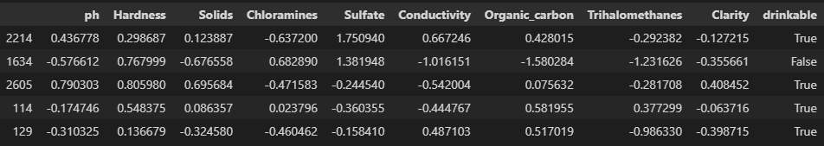
8. Standardization
I am using Robust Scaler for Standardizing the dataset
I am using Robust Scaler for standardization as it less susceptible to skewness and outliers.
Secondly Since our dataset consist of mainly numeric features it is easier to use Robust Scaler
robust scaling uses median and IQR makes it resistant to outliers.

Slide 11
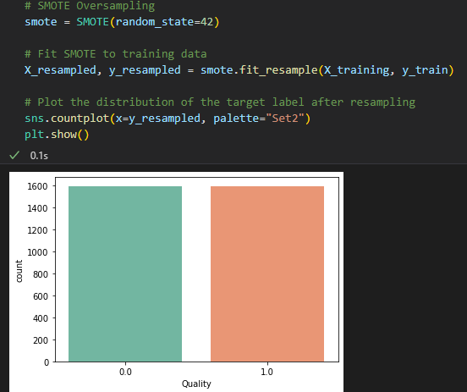
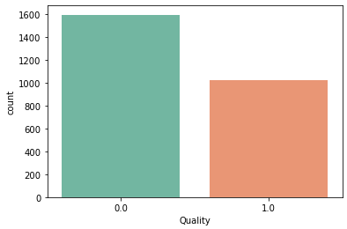
9. Dealing with Imbalanced Target
Imbalanced Target
Model Bias: Imbalanced datasets can lead to bias in the trained model. Since the model is trained to minimize a loss function, it may focus more on the majority class, leading to poor performance on the minority class.
To Deal with imbalanced Target, i will be Resampling my Target, via SMOTE to oversample the Lower Target (1)
Synthetic Minority Over-sampling Technique

Slide 12
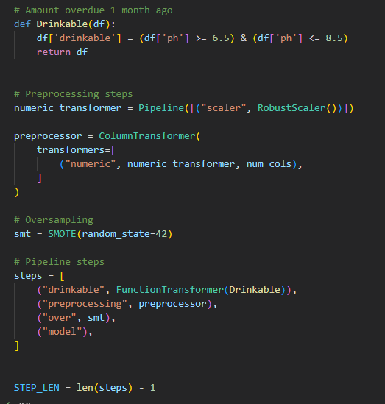
10. Model Selection (Pipeline)
Pipeline
I have used pipeline here as it allows organizing data, training models, and deploying them to make predictions easier.
Pipeline also helps prevent data leakage. data not intended for training could leak out and be used to train the model.

Slide 13
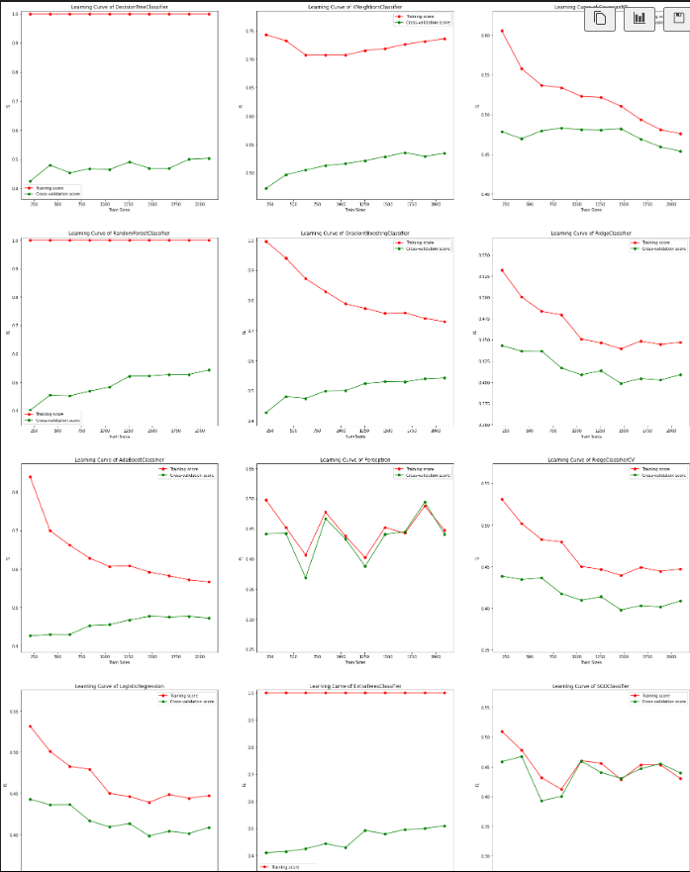
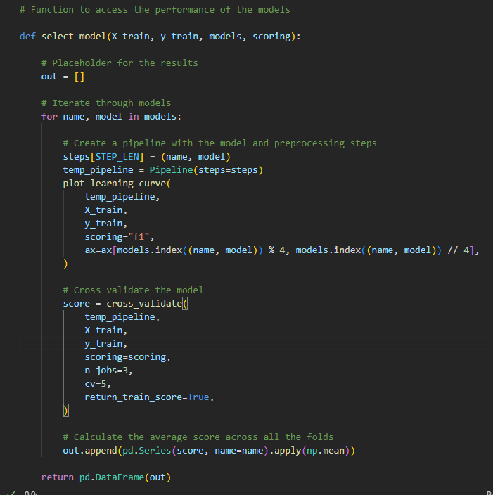
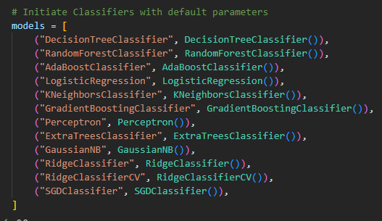
11. Checking through different models
Models
Initiate Classifiers with default parameters
Function to run the models and its scoring methods
plotting the learning curve for each models

Slide 14
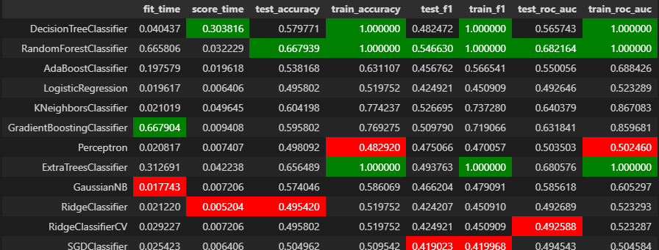
12.Acessing model scoring
Models Scoring
Function to see scores of the model
Model results before hyper parameter tunning
From above we can see that theres no extremly good model where most of the model suffer from overfitting and underfitting.
Because of that i will be choosing a model that fits the best parameters, being F1 score and shows lesser signs of both overfitting and underfitting.
But i will choosing Random Forest as it looks better than the others.

Slide 15
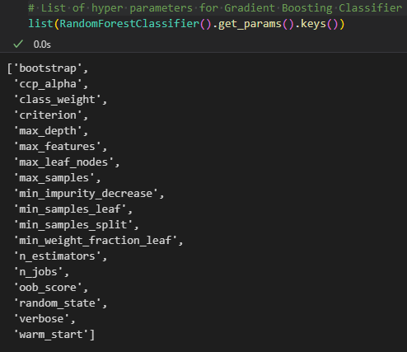
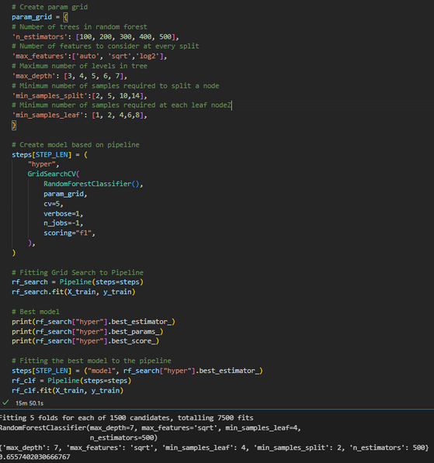
13.Tuning the hyper parameters Random Forest Classifier
Hyper Parameter Tunning
List of hyper parameters for Gradient Boosting Classifier
It is very hard to adjust all the hyper parameters for this model so we will be focusing on these important ones.
Random Forest Hyperparameters we’ll be Looking at:
max_depth
min_sample_split
max_leaf_nodes
min_samples_leaf
n_estimators
max_sample (bootstrap sample)
max_features

Slide 16
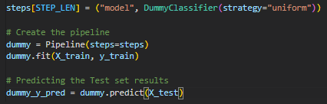
14.Model Evaluation
Evaluation
We will evaluate the model on an independent test set to see if the model is able to generalize to unseen examples.
# Predicting the Test set results
rf_y_pred = rf_clf.predict(X_test)
Baseline Model
A baseline model is simple and interpretable, easy to infer upon. We use DummyClassifier as a baseline to benchmark against.

Slide 17
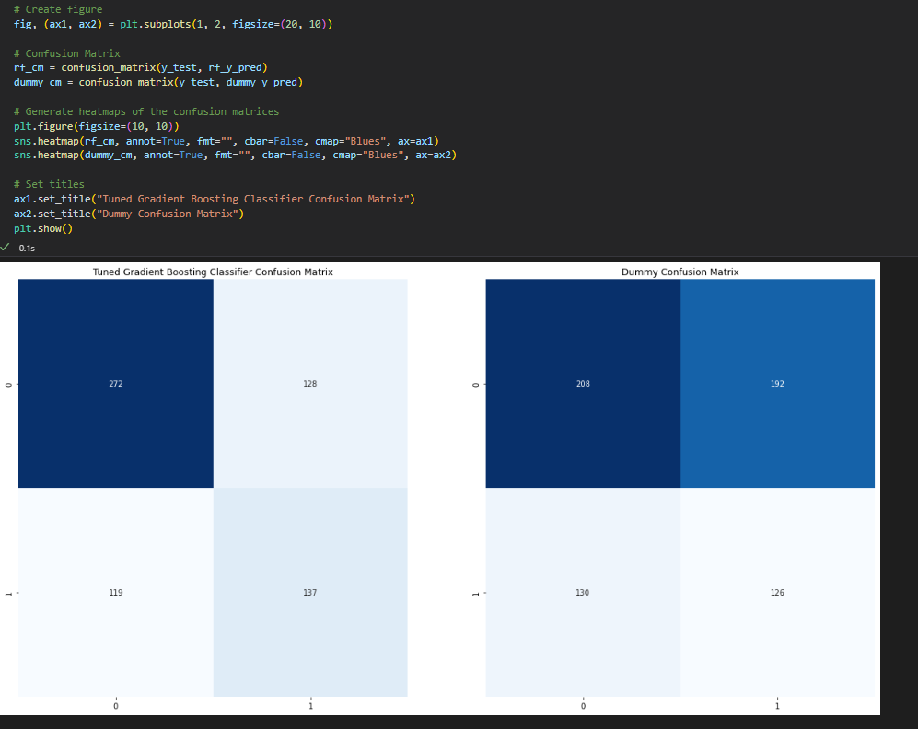
15.Model Evaluation
Comparison between Gradient boosting and Dummy
Confusion matrix

Slide 18
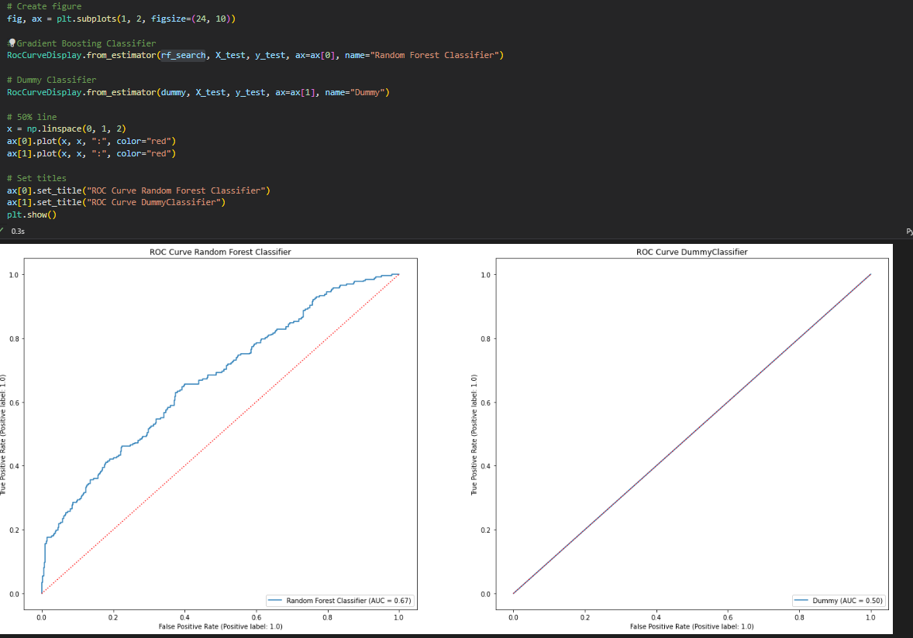
17.ROC CURVE

Slide 19
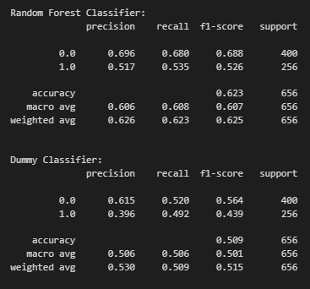
12.End Model Performance

Slide 20
Observation / Conclusion
We can see that the model is able to perform better than the baseline model, as it is making predictions rather than the random guessing being done by the baseline dummy. This can be seen from the higher accuracy and roc_auc score, with our Random Forest classifier having a weighted f-1 score of around 0.63, while the dummy classifier has a weighted f-1 score of around 0.5. Our model is also able to achieve a higher AUC of about 0.67, while the dummy classifier has an AUC of 0.5.
Thus showing that my model out performs the baseline dummy model. We have successfully created a model to predict whether a the quality of water is good or bad. Although the model is somewhat accurate, it is still not good enough to be used in the real world. This is due to insufficient data being available for the model to learn from.

Slide 21
CA1 Regression
Predicting Hospital Cost
REJEY EZEKIEL JEYAKUMAR (2348935)

Slide 22
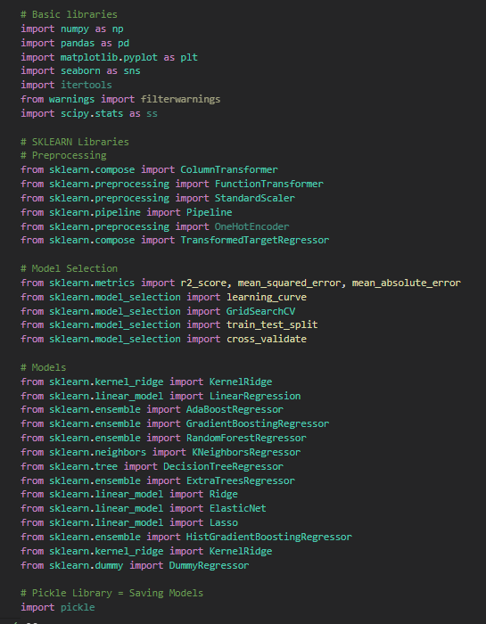
1.Importing
I imported libraries used for Regression.
Secondly i imported my excel file.
Viewing the file

Slide 23
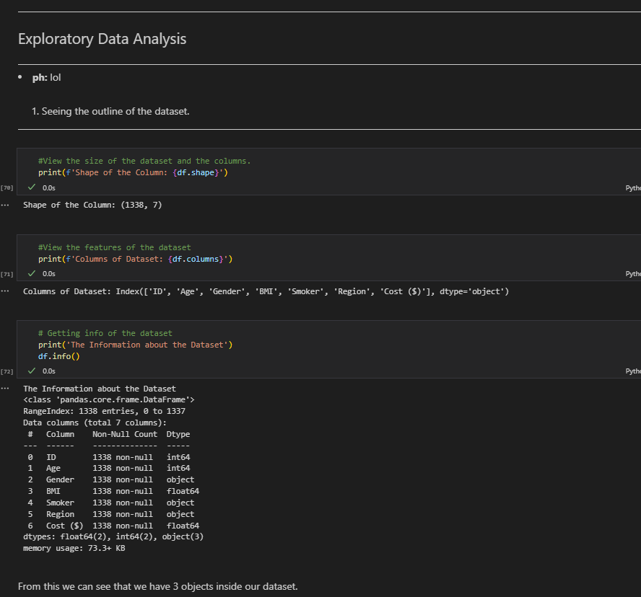
2.Viewing Outline
Viewing outline of the dataset
Viewing the columns of the dataset
Viewing the Target (Quality) Distribution

Slide 24
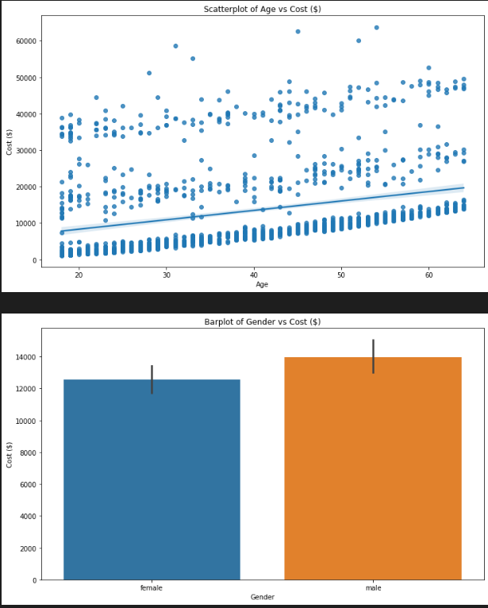
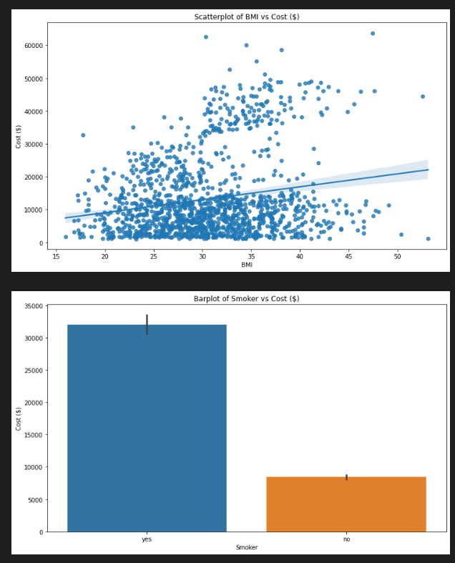
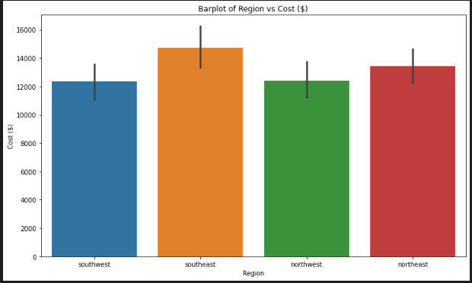
3. Uni Variate Analysis

Slide 25
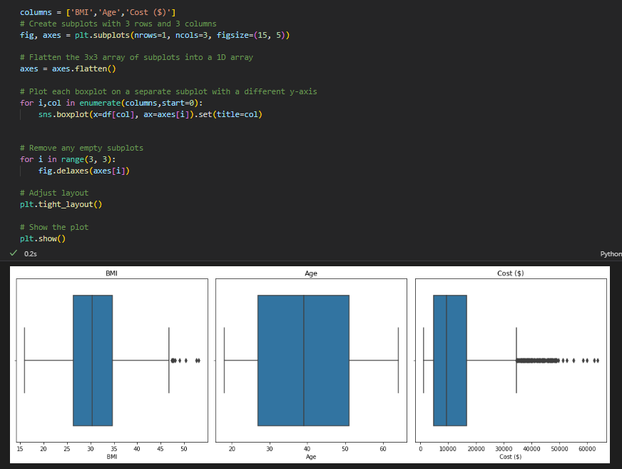
3. Outliers

Slide 26
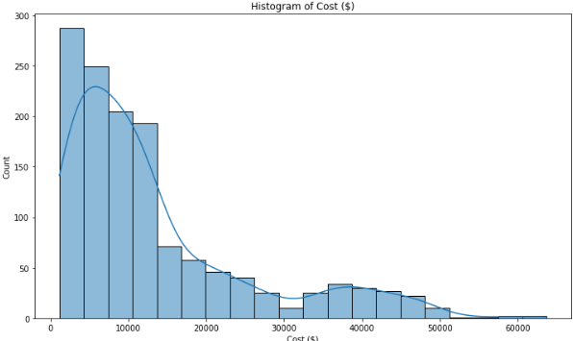
4. Distribution of Target

Slide 27
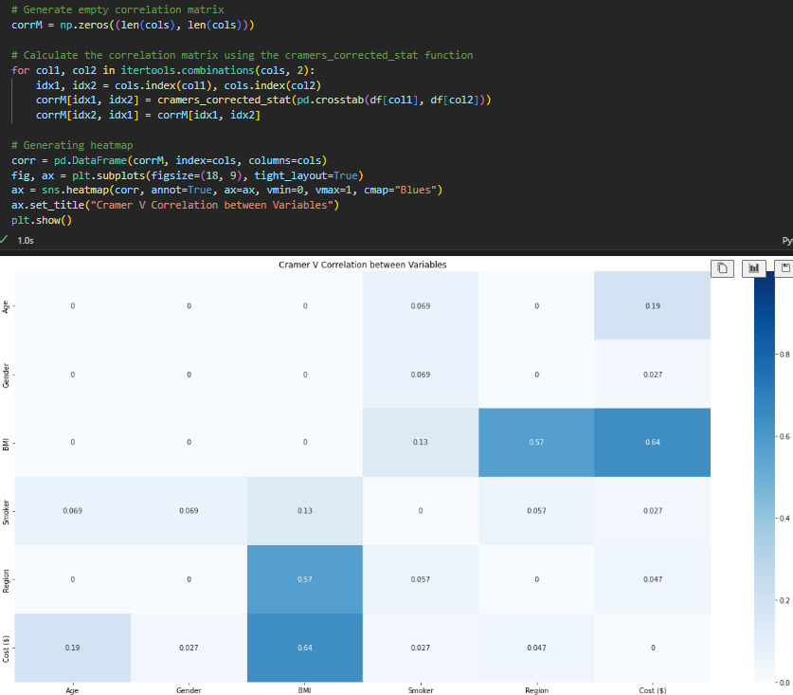
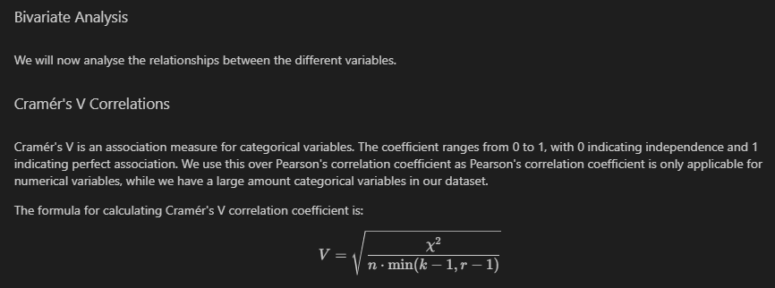
4. Bivariate Analysis

Slide 28
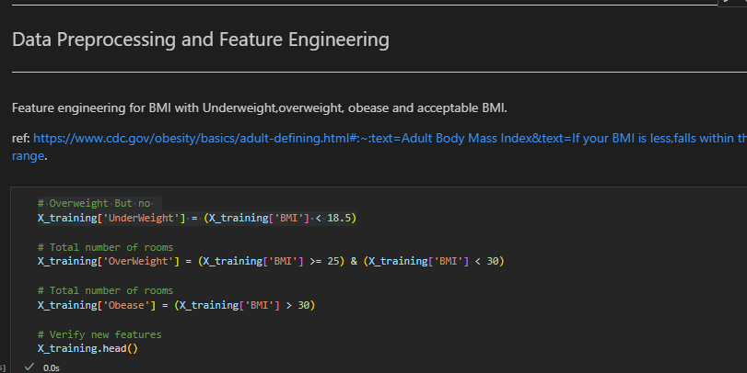
4. Feature Engineering

